Slide 1
Work Planning in Agile

Slide 2
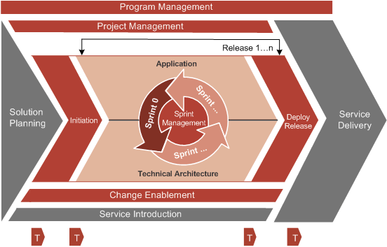
Agile at Accenture - ADM
Copyright © 2015 Accenture All rights reserved.
2
Notes:
Notes to Faculty:
Discuss the major components of ADM for DA and provide details on how ‘Scrum’ is integrated into ADM for DA during sprints phase.
Agile University Delivery School
D01-M02-P01_ADM for Distributed Agile Overview
Copyright © 2012 Accenture All Rights Reserved.
2

Slide 3
Initiation - Overview
Goals and Expectations
Project Plan , Delivery Model and Milestones
High Level Requirements
Current capabilities and Process Gaps
Solution Blueprint
Cost and Schedule
Test Approach
DevOps
Reusable Prototype(s) for Technical Architecture
Copyright © 2015 Accenture All rights reserved.
3
Notes:
Focus
Initiation phase of ADM for DA
Notes to Faculty:
Talk about the interface from this phase to the other phases.
Emphasize the fact that we are just building on top of existing details here and not starting all these from scratch
Note: The yellow circle denotes - The phase is the focus and the picture next to it shows the steps within the phase.
Content
Solution Planning – Initiation phase takes the project forward from the SP. Takes the what and starts talking about the how.
During the Initiation phase
- Project is established – A governance structure is created, the stakeholder goals are established.
- High-level requirements are identified – High-level requirements are identified through JAD sessions and a solution blueprint is formed.
- Packaged Development projects also need to consider the following:
Perform detailed assessment of current organizational capabilities to understand the current working of the systems.
Identify the high level business processes and gaps in the Package. Processes and gaps identified will be crucial inputs to the estimation, release and sprint level planning activities of the project.
- Project Plan is created – High-level estimates, milestones and schedules are created.

Slide 4
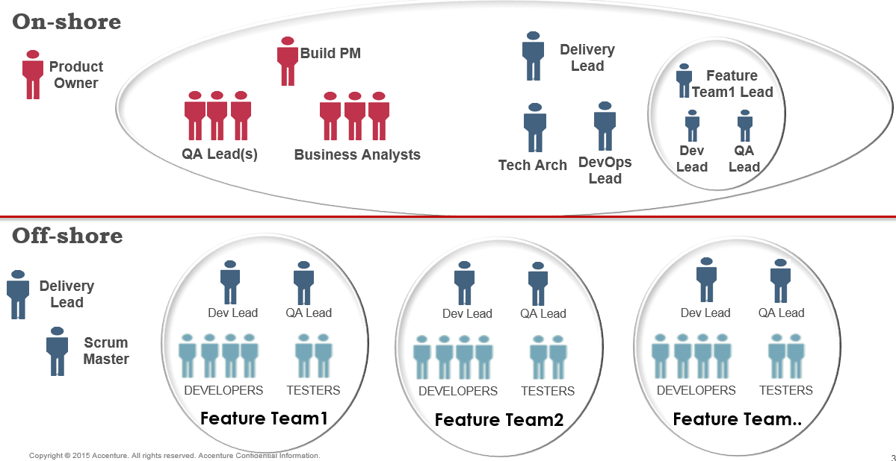
Initiation – Delivery Model for Distributed Agile

Slide 5
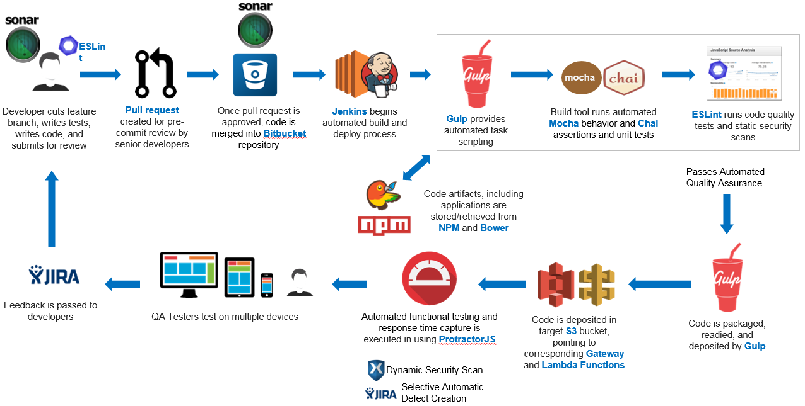
Initiation – DevOps Process

Slide 6
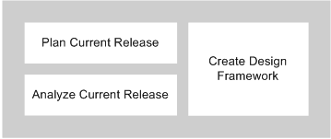
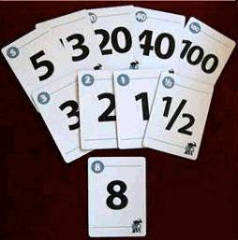
Sprint 0 - Overview
User Story grooming
Release planning with whole team
Planning Poker with Story Points
Sprint Length
Short Release Duration
Product backlog
Sprint Definition of Done
Release Definition of Done
Sprint Definition of Ready
Story Wall/Board
Sprint - Definition of Done
Acceptance criteria is met
All test cases have passed
No major Bugs should exist
Not more than 3 major sonar issues are found
Code coverage is always greater than 70% for all categories
All test cases are automated
Deployed in Integration/Production environment
2 Week Sprint
Team Iteration
Analysis &
Design
Build
& Test
Copyright © 2015 Accenture All rights reserved.
6
Notes:
Focus: Sprint 0 of ADM for DA
Notes to Faculty:
Talk about the interface from this phase to the other phases.
Note: The yellow circle denotes - The phase is the focus and the picture next to it shows the steps within the phase.
Content
Sprint 0 phase creates the plan and schedule for the application work stream and identifies the requirements to be implemented in the subsequent Sprint cycles in the release. Sprint 0 also involves detailing out (use cases, user stories) the requirements, which are in the scope of the current release. Work closely with the Database team during the data model design and ensure a proper mapping exist between the object modeling.
For Packaged projects, Sprint0 also involves performing detailed fit/gap analysis for the Product Backlog items planned as part of the Application sprints. Consider the modules in scope and various integrations required with other modules for the package solutions. The Sprint0 phase would be used to detail out integration architecture, interface architectures, environment data, pre-configuration, etc. which are required for the release.

Slide 7
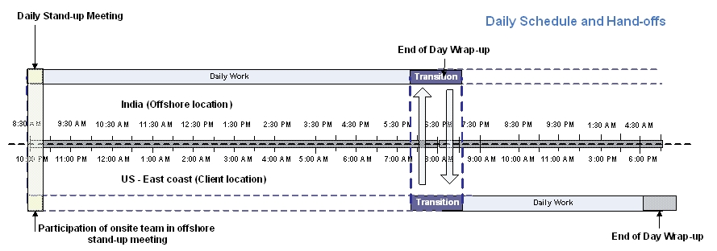
Sprint 0 – Meeting Cadence in Distributed Agile

Slide 8
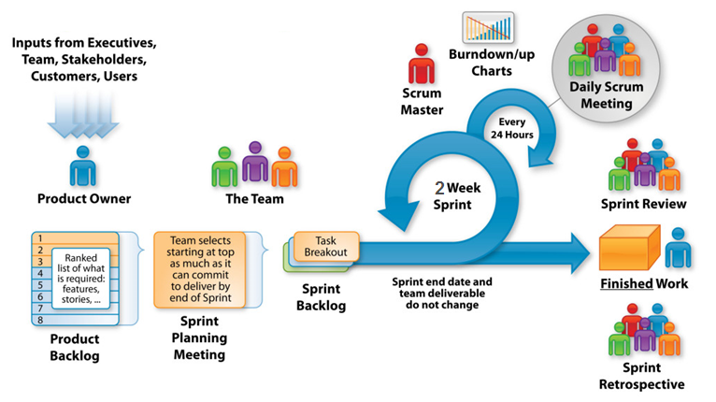
Sprint Application – Sprint Planning
Sprint Planning
Sprint Backlog
Daily Standup
Sprint Review/Demo/Retrospective
Availability of Product Owner
Manual acceptance test with each User Story
Story Points with velocity metrics
Sprint Burn down chart
Emergent Design
Continuous Integration
Automated Deployment
Collaboration Tools
Product Backlog Refinement
Code refactoring within the sprint
System Integration Testing
Working software at end of every sprint
Test Driven Development
UAT within sprint
Devops Process
User Story sized to fit within 1 Sprint
Automated Unit Test

Slide 9
Sprint Application– 2 Weeks Sprint Execution
Mon | Tues | Wed | Thurs | Fri
1 | 2 | 3 | 4 | 5
8 | 9 | 10 | 11 | 12
15 | 16 | 17 | 18 | 19
Sprint Start
Build Start
Sprint Planning
Sprint Low Level Design, DB Setup and Build
User Story Tasks breakdown
Sprint QA Test Planning and Test Scripts
Daily Stand-Up
User Story Tasks effort estimation
Sprint Low Level Design, Build and UT
Sprint QA Test, Regression Test Execution
Daily Stand-Up
Product Backlog Refinement for Next Sprint
Build End
Sprint End
Story Point Estimation for Next Sprint
Sprint Demo
Sprint QA Test, Regression Test Execution
Sprint Retrospective
Daily Stand-Up
Sprint Planning for Next Sprint
Copyright © 2015 Accenture All rights reserved.
9

Slide 10
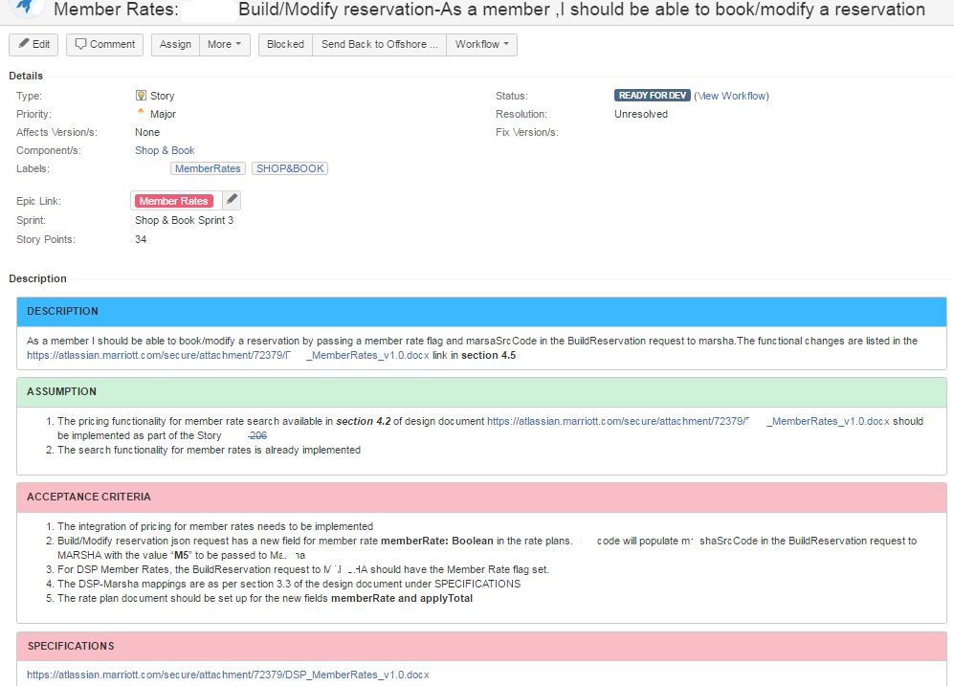
Sprint Application – User Story

Slide 11
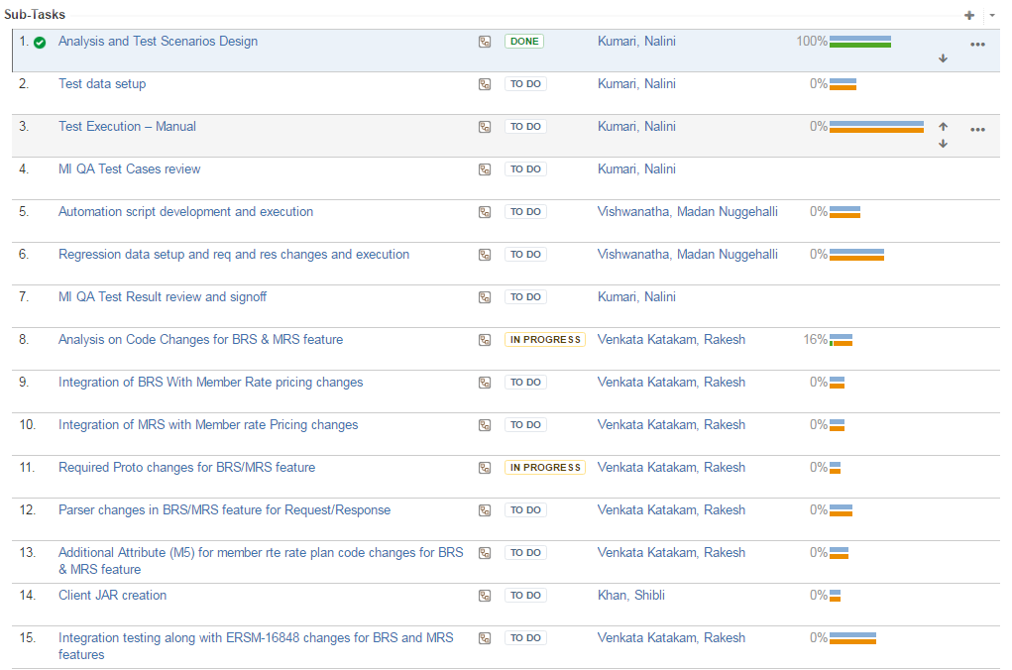
Sprint Application – Sub tasks in a User Story

Slide 12
Sprint Application – Retrospective
Feature Team 1
What Went Well ?
Member Rates Publish Story was completed without defects
Uploaded all cases in JIRA and Executed them, which made tracking Easy
What did not go well ?
Multiple deployments by Feature team 2
Impact : QA Environment is unstable
Jenkins job was not created by the client on time for the new service
Impact : Build was delayed
Improvements
Streamline the process of deployments by multiple teams ---------------------------------------------------------------------------------------- Priority 2
Inform the DevOps team after the sprint planning to create the Jenkins Jobs so we could have it ready in time. -------------------- Priority 1

Slide 13
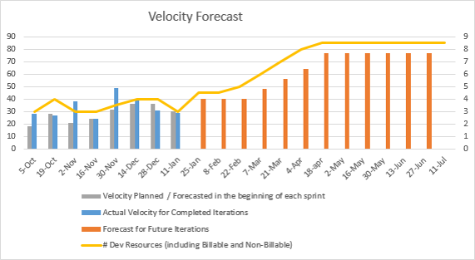
Agile Metrics - Velocity Forecast

Slide 14
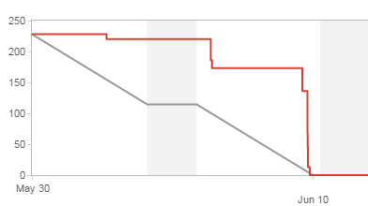
Agile Metrics – Sprint Burndown
Impediment in deployment

Slide 15
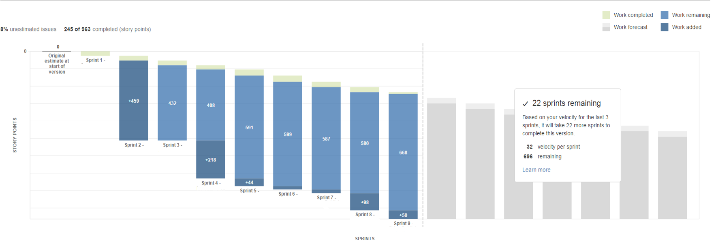
Agile metrics - Release forecast

Slide 16
Deploy Release
Based on the business need, few projects would opt to perform end-to-end testing and full deployment activities for every Sprint.
During Deploy Release, the team does the final round of testing and the application gets deployed to production.
Copyright © 2015 Accenture All rights reserved.
16

Slide 17
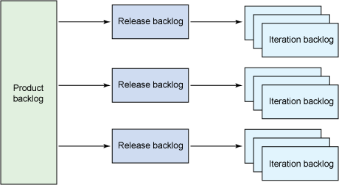
Change Control in Agile
Flexible and Responsive to Change
No Change should Jeopardize Sprint Commitment
Small, trivial changes should be done directly by the team without a Change Request
Quick Informal Email Approvals
Accelerated Change request Cycle
Lower Cost
Cancel Sprint and plan with remaining sprint
Change Allowed
Change Could lead to CR#
Copyright © 2015 Accenture All rights reserved.
17
Notes:
Focus
This slide sets the context of the relevance of Change Control for Agile projects.
Content
Define Change Control in traditional projects. Without change Control, the project will have scope creep and will result in effort/schedule/cost overrun. Change Control is important for FP as well as T & M projects.
Discuss some advantages of Change Control
Explain how Agile projects are different from traditional projects.
And then leave an open question whether change Control is compatible with Agile.
Agile University Delivery School
D02-M02-P05_Change Control
Copyright © 2011 Accenture All Rights Reserved.
17

Slide 18

Questions?

